Slide 1














STUDENT
INFORMATION
SYSTEM
pROJECT MEMBERS:
2214025: MALCOLM ANTAO
2214032: NATHANIA BAPTISTA
2214035: P JAYESH NAIDU

Slide 2







INTRODUCTION

Slide 3





What is an SIS?
The Student Information System (SIS) is a comprehensive web-based platform designed to manage and streamline essential information related to students, teachers, and administrators in educational institutions.
The SIS features a Student Dashboard for viewing academic records, attendance, and personal information; a Teacher Dashboard for managing personal information, grading, and student performance reports; and an Admin Dashboard for overseeing all operations, user management, and managing access.
By integrating these modules, the system enhances data accuracy, reduces manual work, and ensures real-time data availability, ultimately fostering a more efficient and connected school environment.

Slide 4
DESIGN

Slide 5

DIAGRAMS INCLUDED
ER DIAGRAM
SCHEMA

Slide 6
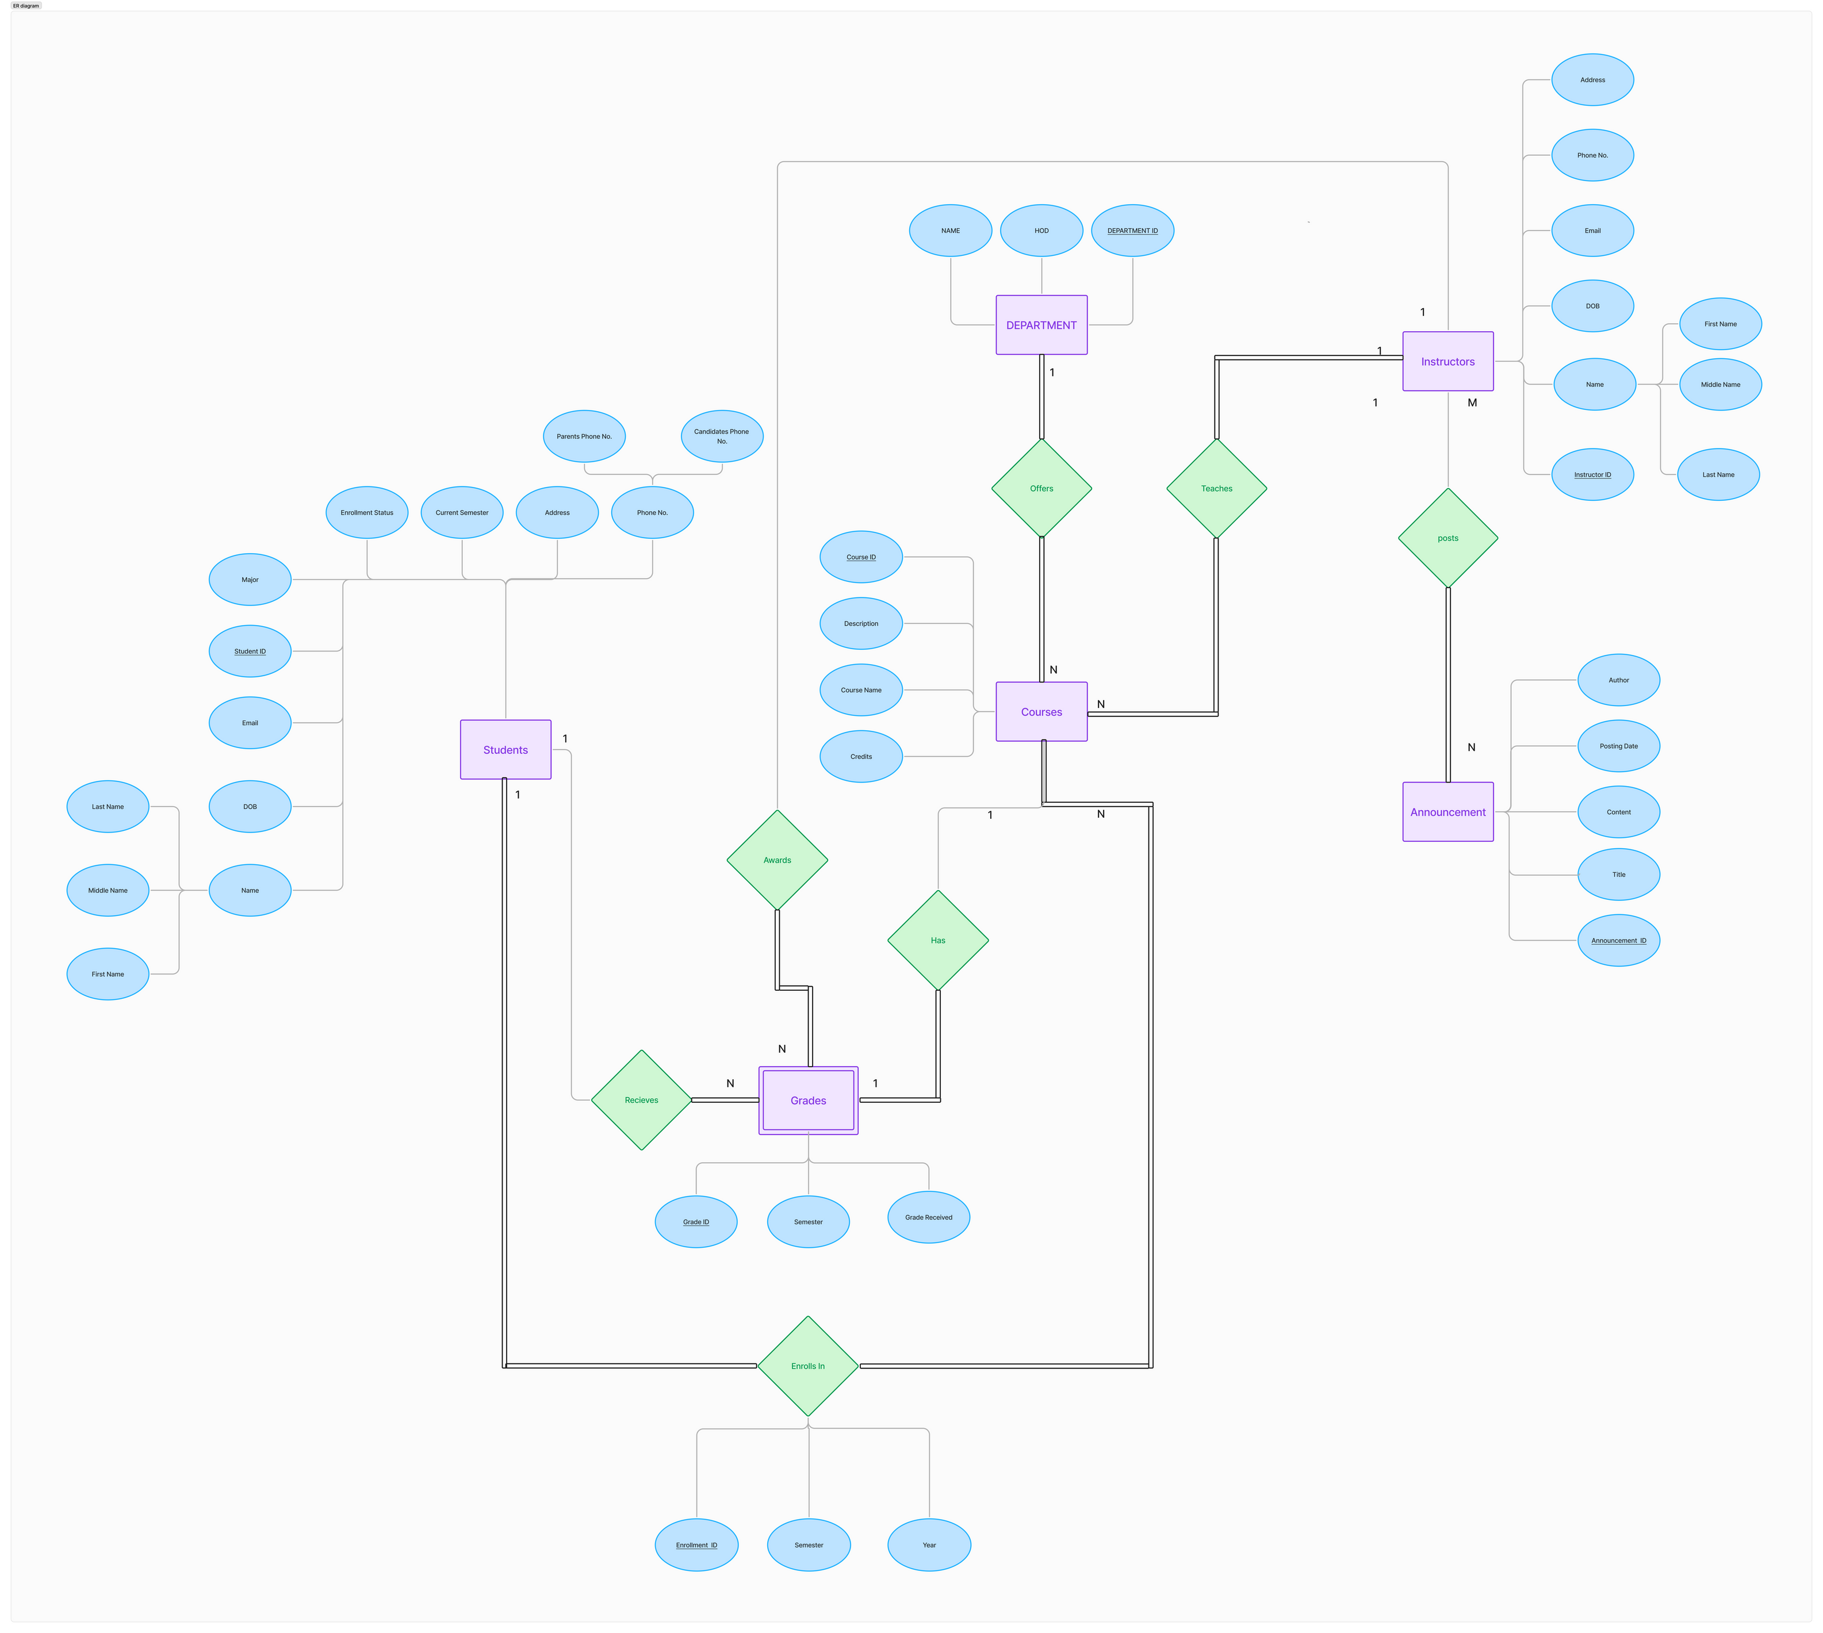

Slide 7
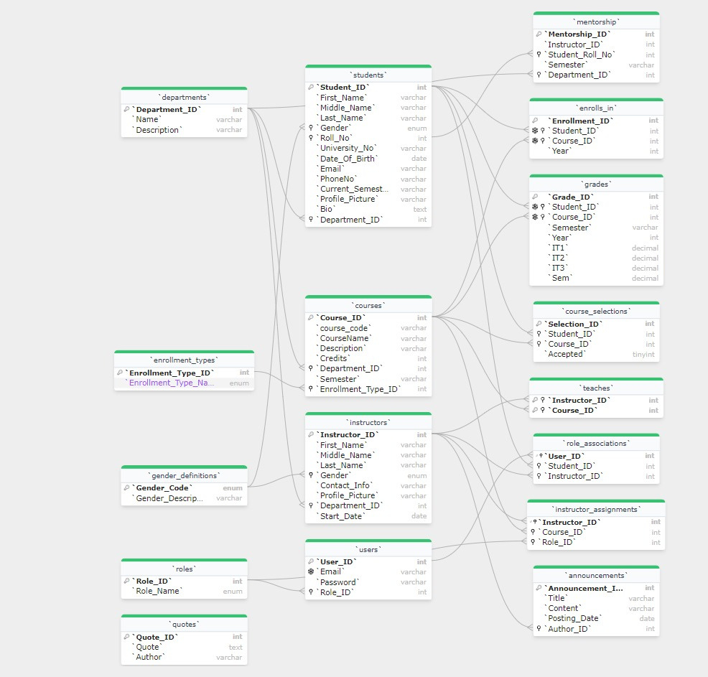

Slide 8
IMPLEMENTATION

Slide 9



CONCLUSION
In conclusion, the Student Information System (SIS) project provides a centralized, efficient, and user-friendly platform for managing essential educational data within an institution.
By integrating features for students, teachers, and administrators, the SIS significantly reduces manual tasks, enhances data accuracy, and improves communication across all user levels.
Ultimately, the SIS is an invaluable tool that empowers institutions to meet the evolving demands of modern education.

